Slide 1

MICRO CREDIT DEFAULTER PROJECT
Submitted by: Haindavi Chakravarthi
Internship : 23

Slide 2
Table of contents:
Introduction
Analytical Problem Framing
Data Analysis
Pre-processing
Visualizations
Building the models
Conclusion
Limitations and Scope for Future Work

Slide 3
INTRODUCTION:
A Microfinance Institution (MFI) is an organization that offers financial services to low-income populations. MFS becomes very useful when targeting especially the unbanked poor families living in remote areas with not much sources of income. The Microfinance services (MFS) provided by MFI are Group Loans, Agricultural Loans, Individual Business Loans and so on.
Many microfinance institutions (MFI), experts and donors are supporting the idea of using mobile financial services (MFS) which they feel are more convenient and efficient, and cost saving, than the traditional high-touch model used since long for the purpose of delivering microfinance services. Though, the MFI industry is primarily focusing on low-income families and are very useful in such areas, the implementation of MFS has been uneven with both significant challenges and successes.
Today, microfinance is widely accepted as a poverty-reduction tool, representing $70 billion in outstanding loans and a global outreach of 200 million clients.
We are working with one such client that is in Telecom Industry. They are a fixed wireless telecommunications network provider. They have launched various products and have developed its business and organization based on the budget operator model, offering better products at Lower Prices to all value conscious customers through a strategy of disruptive innovation that focuses on the subscriber.

Slide 4
They understand the importance of communication and how it affects a person’s life, thus, focusing on providing their services and products to low-income families and poor customers that can help them in the need of hour.
They are collaborating with an MFI to provide micro-credit on mobile balances to be paid back in 5 days. The Consumer is believed to be defaulter if he deviates from the path of paying back the loaned amount within the time duration of 5 days. For the loan amount of 5 (in Indonesian Rupiah), payback amount should be 6 (in Indonesian Rupiah), while, for the loan amount of 10 (in Indonesian Rupiah), the payback amount should be 12 (in Indonesian Rupiah).
Here with the historical data of the customers on repaying the loan amount, we will predict the defaulters through machine learning model.

Slide 5
ANALYTICAL PROBLEM FRAMING:
Here our dataset has 209593 rows and 37 columns, using this dataset we will be building the model followed by training the data and then finally the model is tested by using 67% of the training data and 33% of the testing data.
Here the data has no null values and even then, we face skewness and outliers over here for certain variables which we treat for the better accuracy of our model.
Also, here we face the problem imbalanced data where the count of defaulters is much less than the non-defaulters which should be treated.

Slide 6
DATA ANALYSIS:
Unnamed: 0 – This column is just as the index and does not have any affect on the model building and so we can delete the column and proceed.
msisdn - This column is the user mobile number and is not at all useful for predicting and model building.
Pcircle - The data present in the column “pcircle” is same throughout the records and so we can delete the column as it is of no use for our prediction.
Here we have the features with “Float and int” datatypes except the feature “pdate” which is “object” datatype and from this feature multiple new features are to be extracted and then further they are changed to the appropriate datatypes.

Slide 7
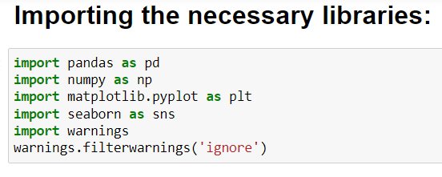
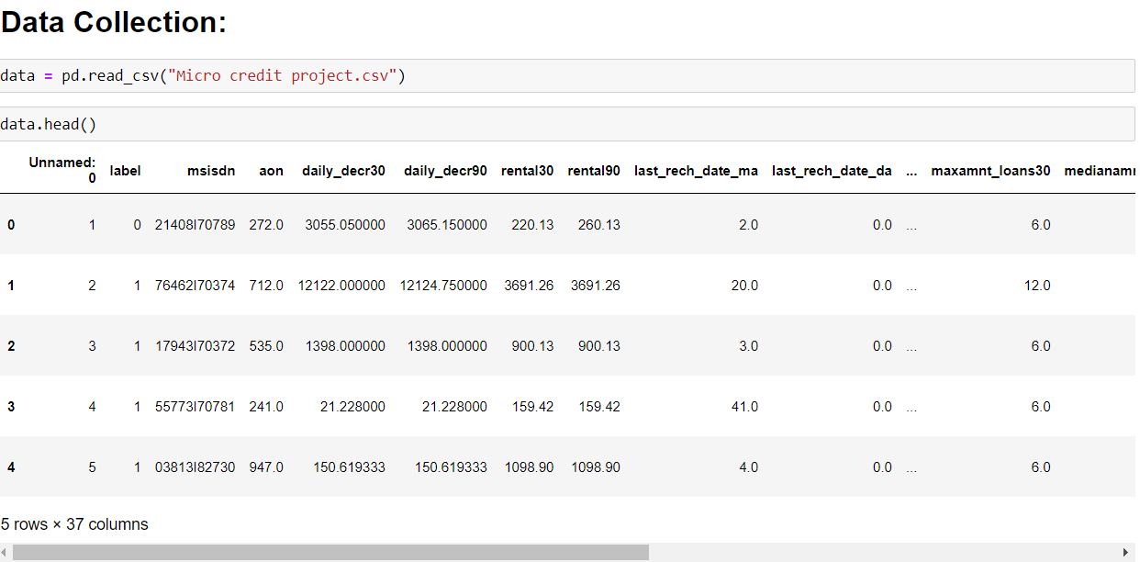
Here we can see that the data has unnecessary column like "unnamed0" which is not at all necessary and also there may be few features which are irrelevant and so there are pre-processing steps needed to be done for the better model building.

Slide 8
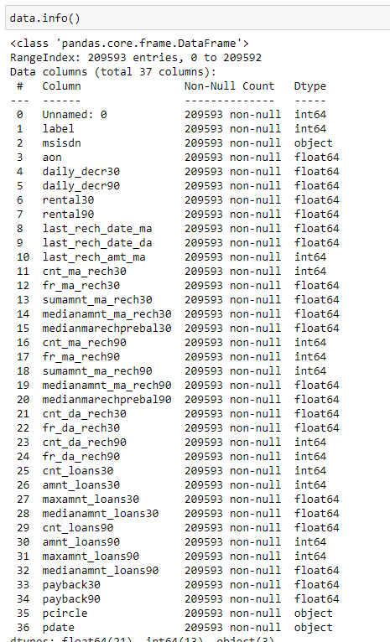
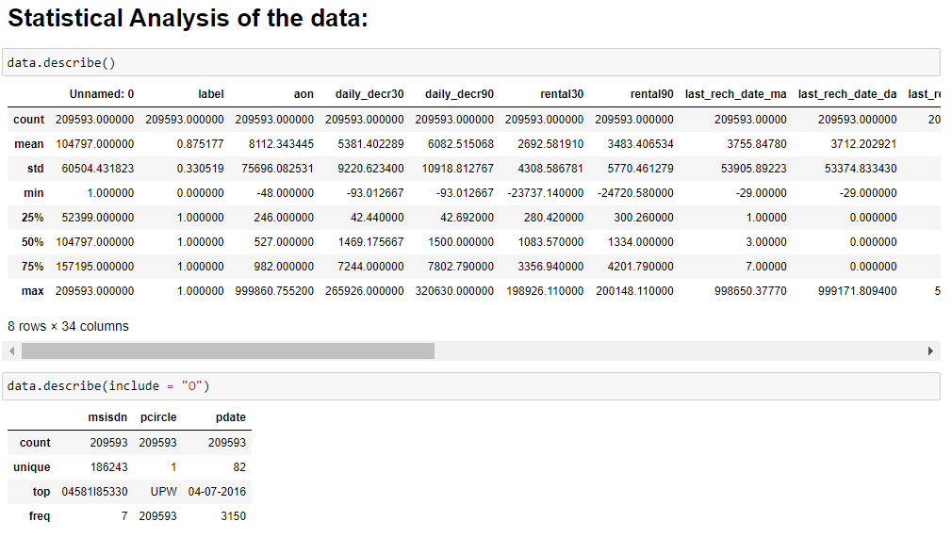
Here we have the features with “Float and int” datatypes except the feature “pdate” which is “object” datatype and from this feature multiple new features are to be extracted and then further they are changed to the appropriate datatypes.
Here we have come to know that the data has no null values and all the features of the dataset has the data in it.
Here the data has few columns in which the difference between mean and the standard deviation is more and, in few columns, it is less and is appropriate that few columns has mean value higher than standard deviation value and also there are few columns in which standard deviation is higher than the mean value and also we can see that statistical analysis of the object datatype columns also in which the unique values of the data are mentioned and also we get more information regarding the frequent values present in the data of the columns

Slide 9
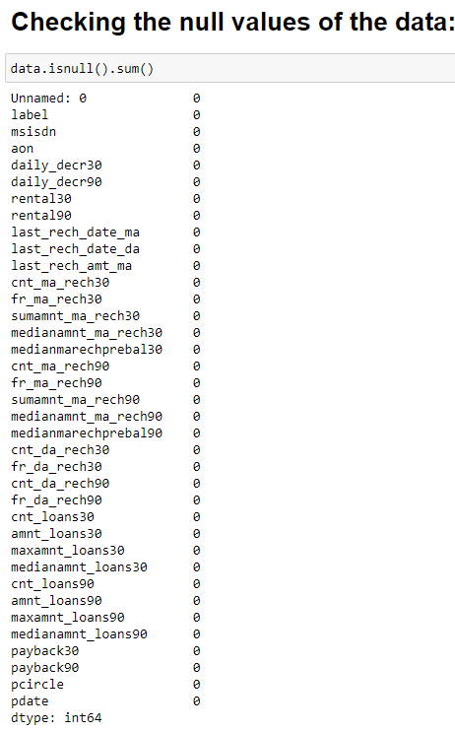
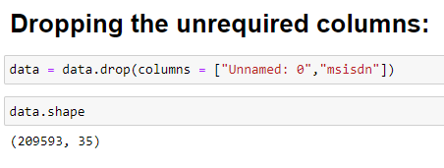
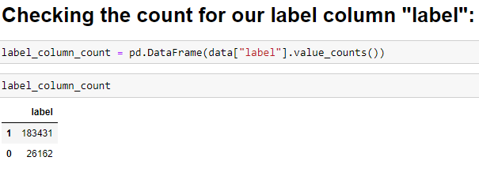
Here we can see that the data has no null values in any of the features.
Here the features “Unnamed: 0” and “msisdn” have been removed which are not at all useful for the model building and which don’t rely to the dataset.
Here we can see that the label column has imbalanced data in it and we have to balance the data and then proceed with our model building.

Slide 10
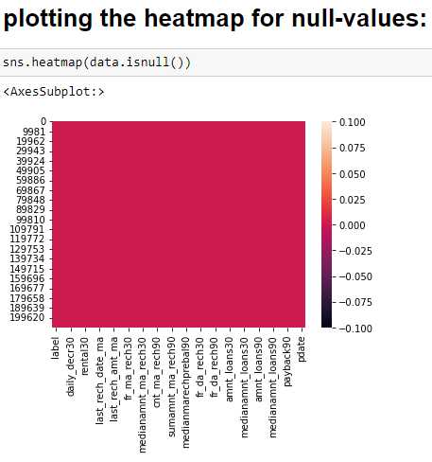
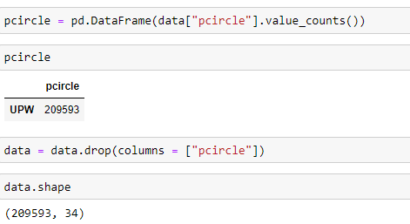
Here we can see that the data has no null values in it and so heatmap is with unicoloured.
PRE-PROCESSING:
Here first of all we have seen the data present in the column “pcircle” and which we got to know that is same throughout the records and so we can delete the column as it is of no use for our prediction.

Slide 11
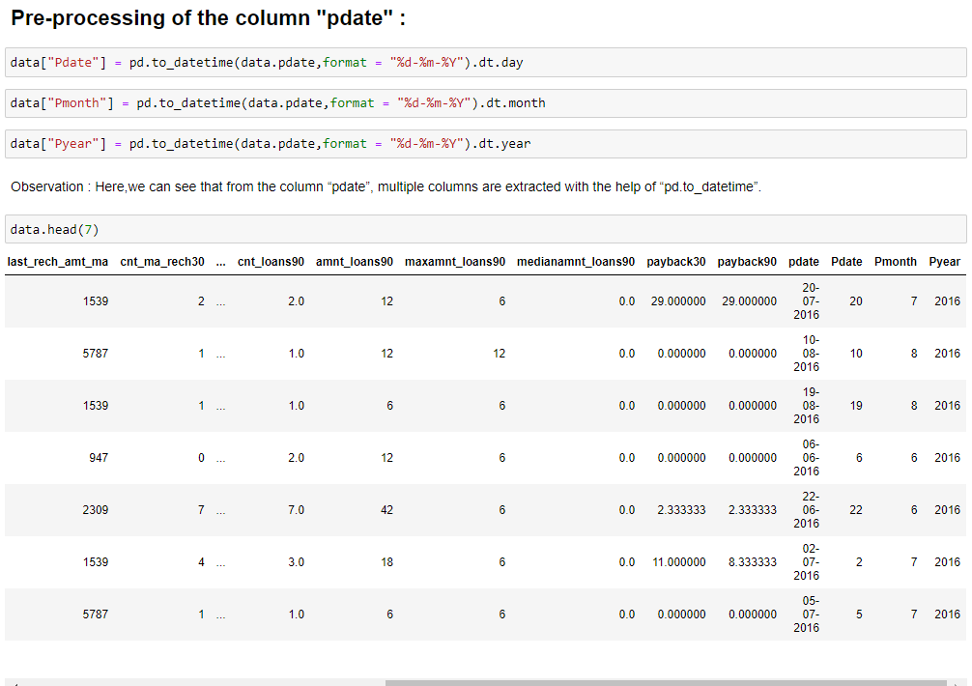
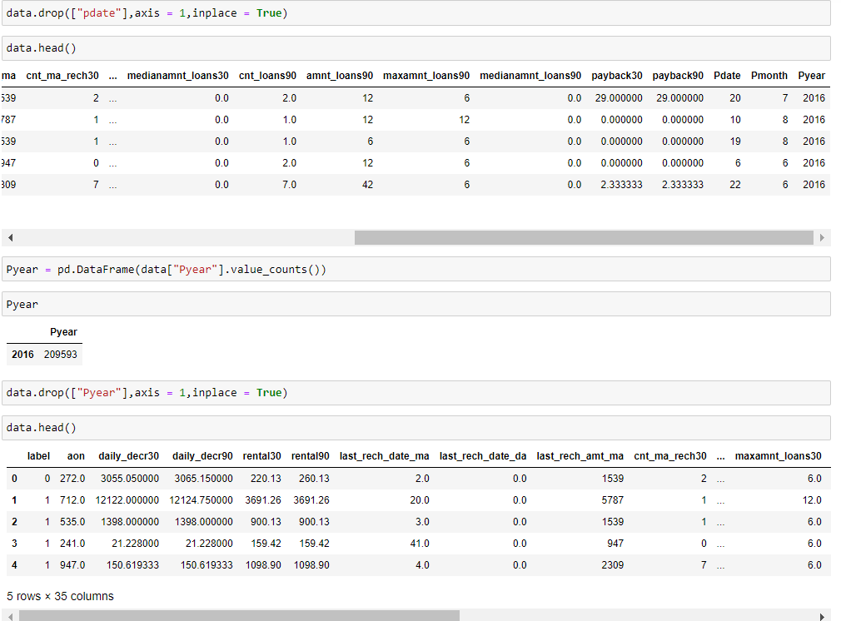
Here can see that the additional columns are added at the end of the dataframe and nextly the parent column is dropped from the dataframe
Here the newly created column “pyear” has the entire data filled with only one type of data and is no use and so we can drop this column.

Slide 12
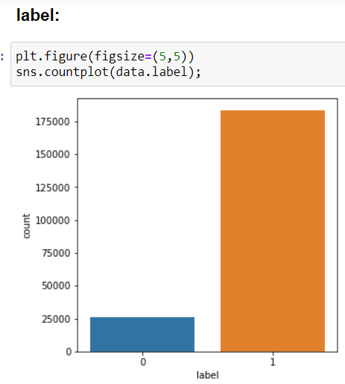
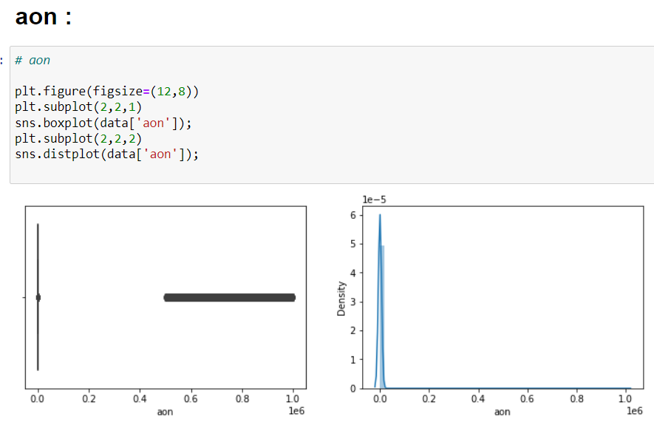
VISUALIZATION:
Here we will have a look at the visualizations of few of the columns.
Univariate Analysis:
Here we can see that the column has an attribute(non-defaulter) with very high count than the other attribute (defaulter).
Here we can see that the column has many numbers of outliers present and also there are dense in nature and the distribution peak is very narrow.

Slide 13
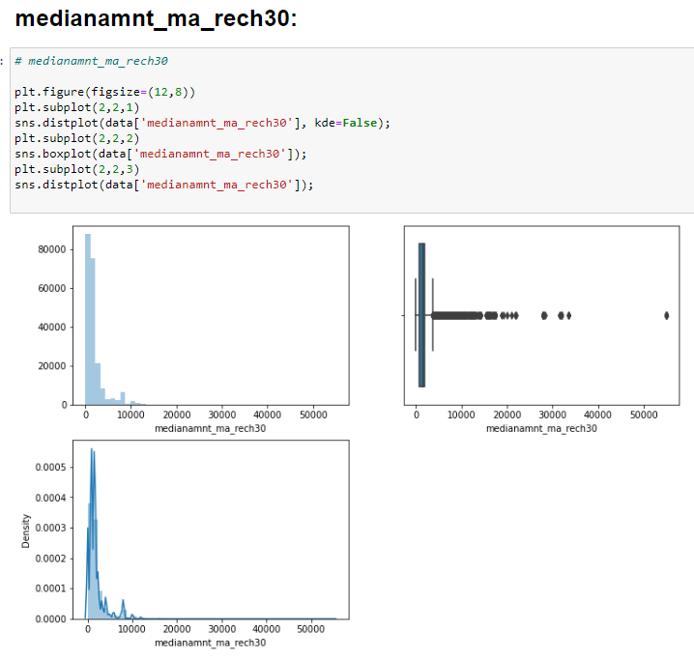
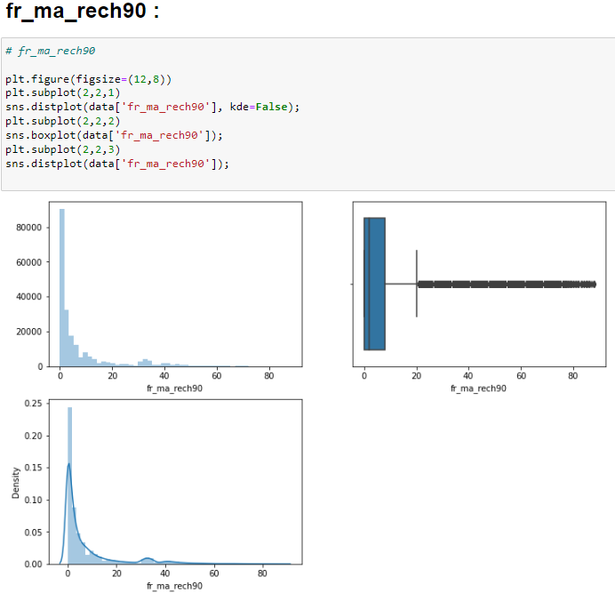
Here we can see that the column has a large number of outliers which are dense in nature and the distribution curve has multiple peaks and also is with skewness.
Here we can see that the column has many outliers which are very dense in nature to the quartile and distribution curve has much skewness and the peak is also narrow in nature.

Slide 14
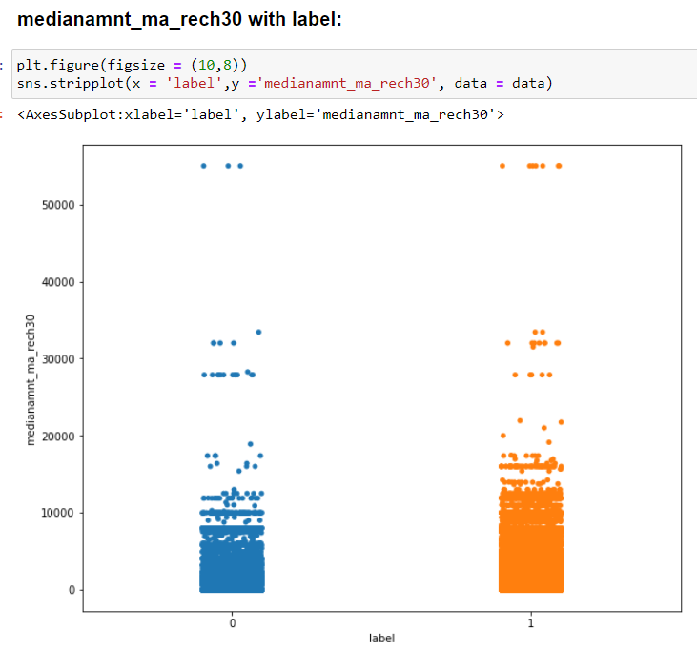
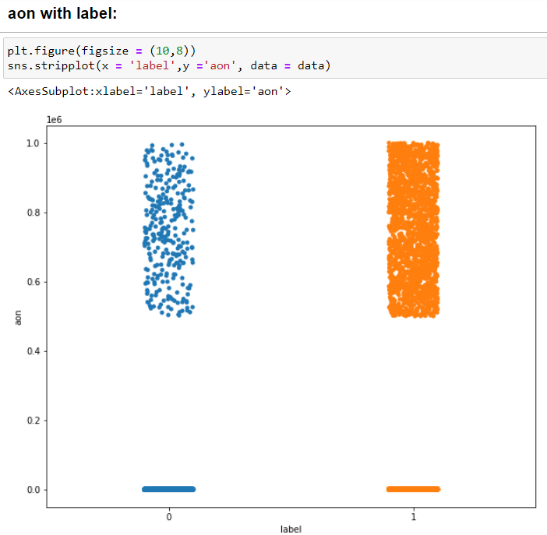
Bivariate Analysis:
Here we can see that there is high density of customers is for both the label attributes at their starting points is same but as the amount for the last recharge increases there, we can see the decrease in the density of the customers and at the highest last recharge amount point the density for both of the label attributes is almost same but when compared to label 0 ie., defaulters the label 1 ie., non-defaulters attribute has the high density.
Here we can see that the label 1 attribute has high and dense customers than the label 0 attribute.

Slide 15
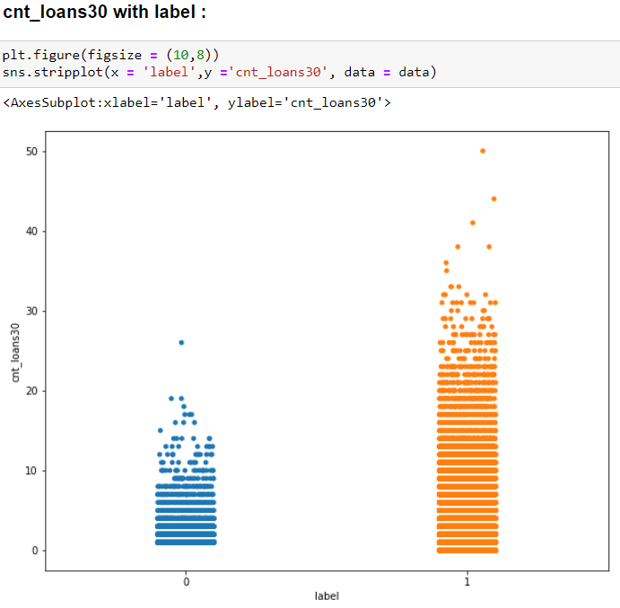
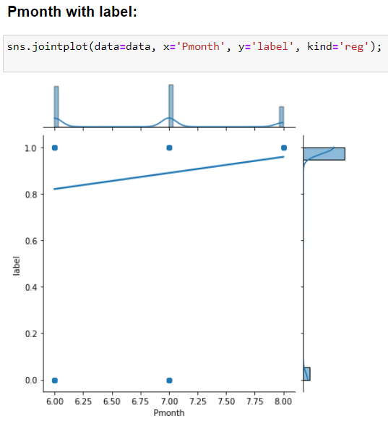
Here we can see that the customers who are non-defaulters are more in number for the number of loans taken in last 30days.
Here we can see that both of the label attributes have same density in both of the 6th and 7th months but the label 1 attribute also has customers in 8th month which are absent in label 0 attribute.

Slide 16
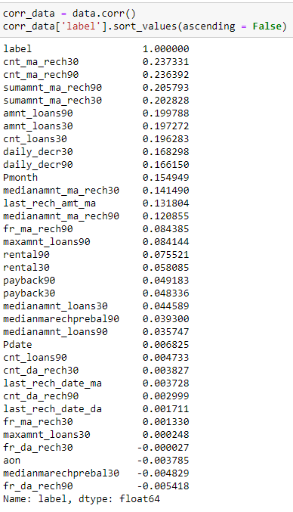
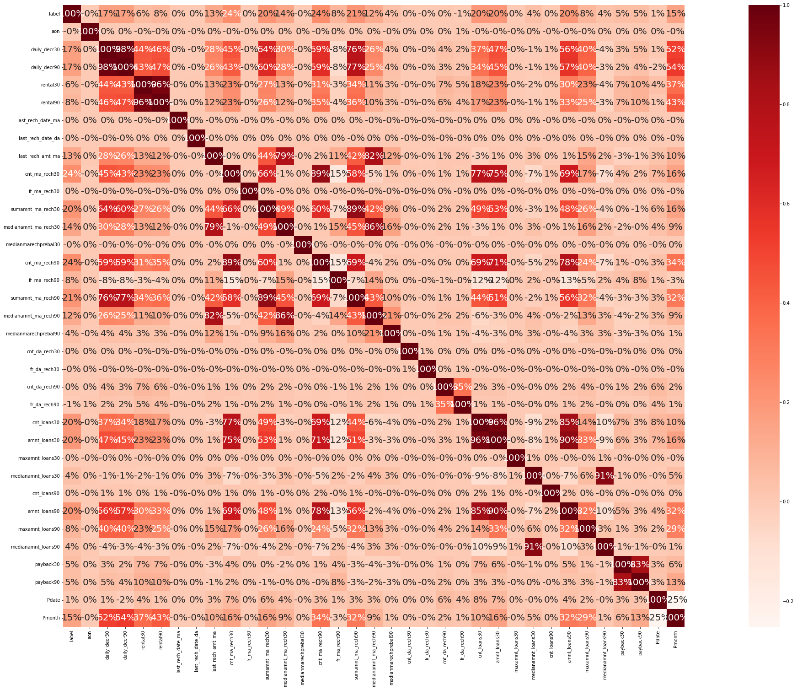
Correlation:
Here we find the correlation between the features and the label
Here we can see that the maximum correlation is present between:
a) medianamnt_loans90 and medianamnt_loans30 b) rental_90 and rental_30 c) daily_decr90 and daily_decr30 d) amnt_loans90 and amnt_loans90 e) cnt-loans30 and amnt_loans30 etc..
we have a lot features which with high correlation above 80%

Slide 17
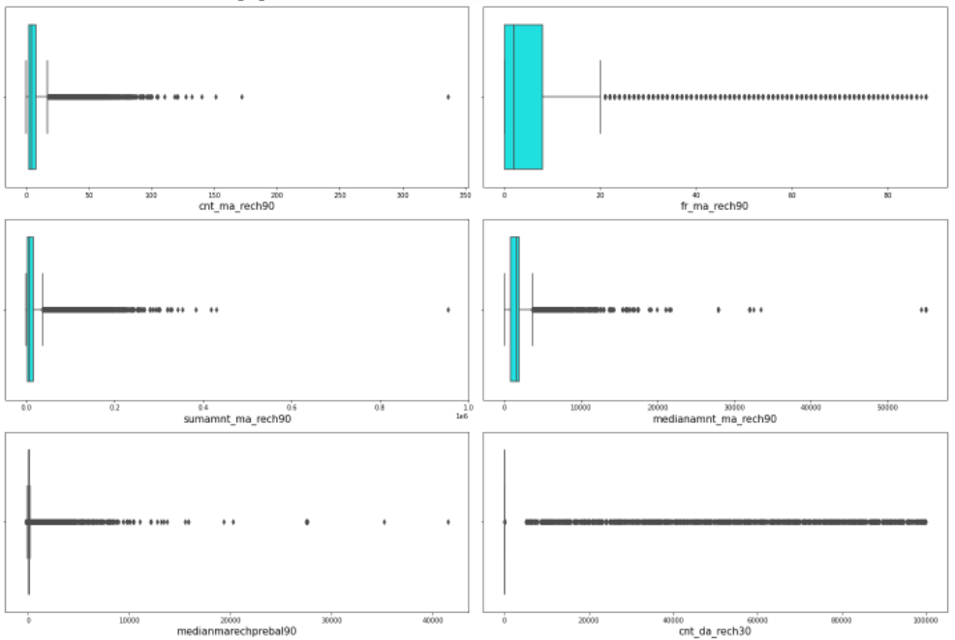
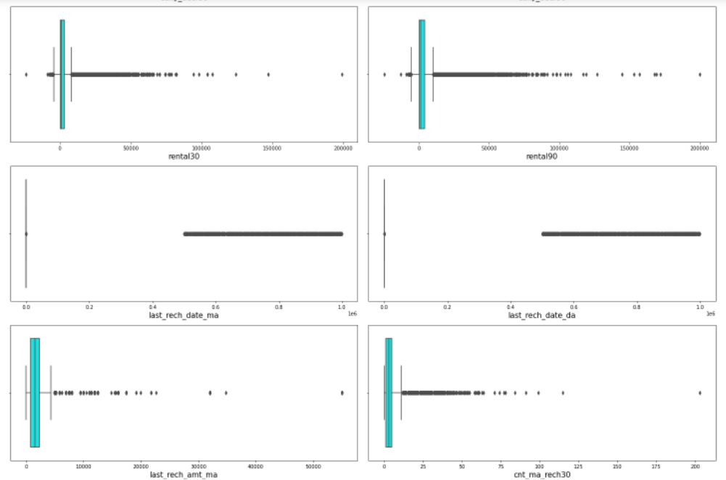
Detection of the Outliers:
Here we will find the outliers present in the different features of our data. Here we will see the outliers of few of the features.
Here we can see that most of the columns have outliers present in them and also with dense and also with number of outliers present and so we have to treat them for better accuracy in our model building.

Slide 18
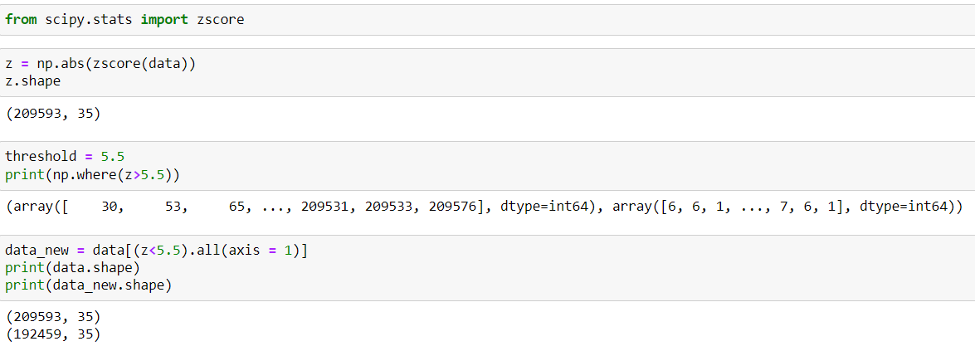
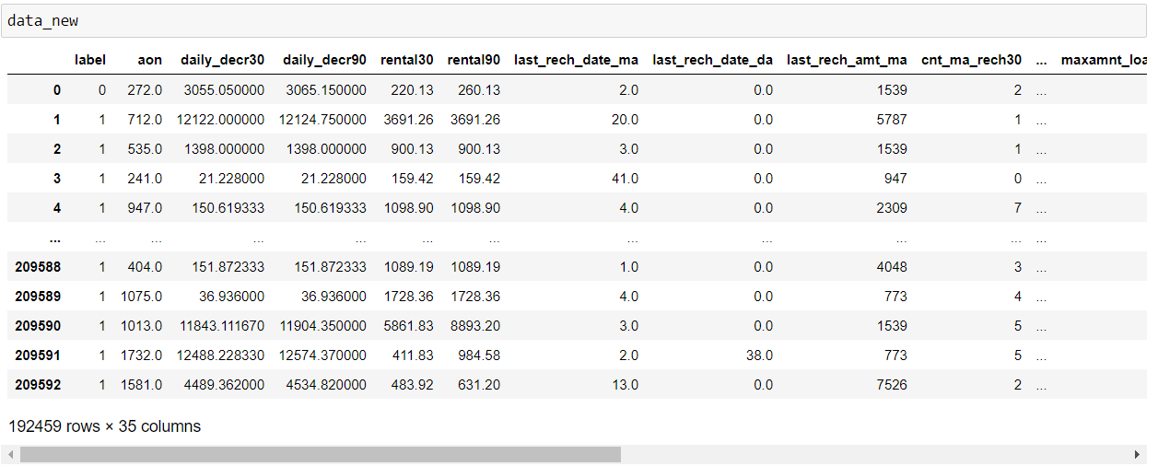
Treating the outliers:
Here we use Z-Score method for treating the outliers present in the columns of the data.
Here we can see that we have taken 5.5 as threshold as we cannot afford of losing more than 8% of the data and we can see that the number of records have been decreased to extent which means we have succeeded in treating the outliers to some extent.
Now here we can see that our dataset has a smaller number of records compared to before which indicates that we have treated the outliers also to some extent.

Slide 19
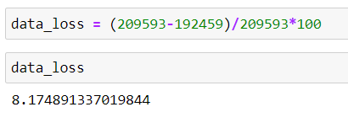
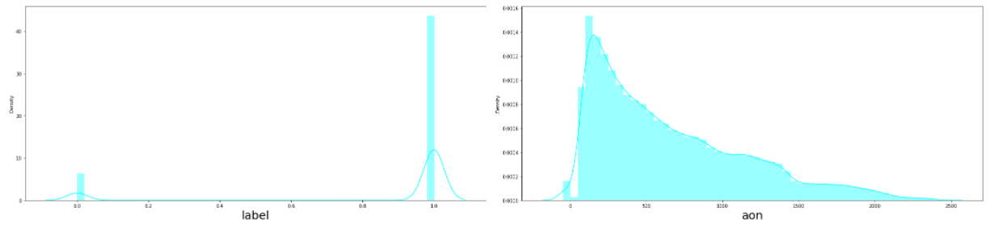
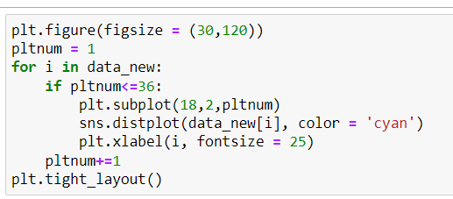
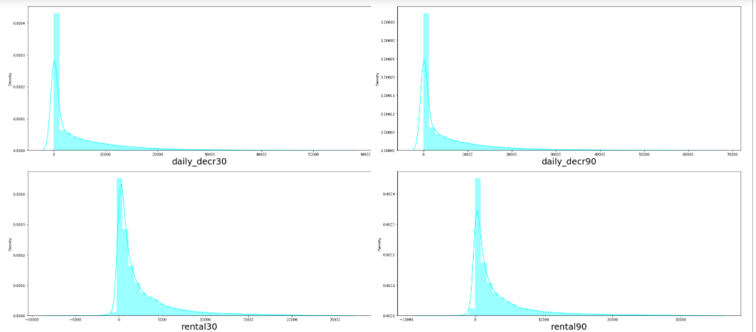
Data loss%:
Here we have lost almost 8% of the data, we could have taken less threshold and could have removed outliers more but as the data is expensive we cannot afford to loss more than 8% of the data.
Checking the skewness of the few columns of data:

Slide 20
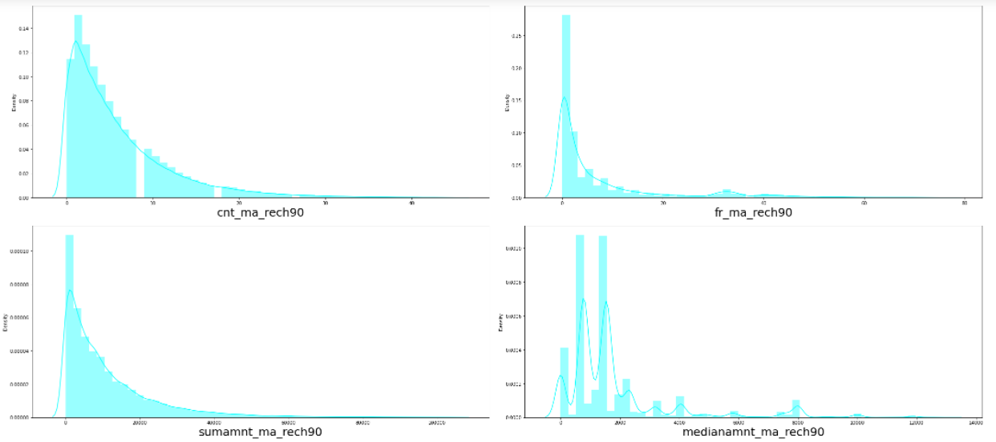
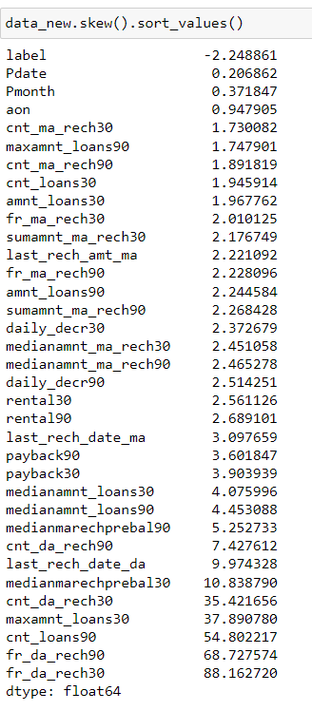
Here we can see that the columns have skewness and we will have a look at the skew values of the features with the label column.
Here most of the features have skewness and except the label column all the other feature columns are positively skewed, in that few columns are with medium positive skewness and there are also few columns with very high positive skewness.

Slide 21
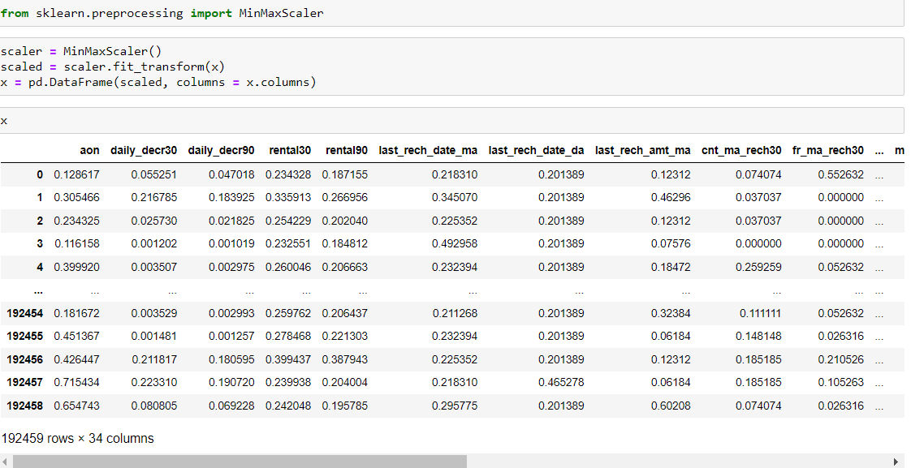
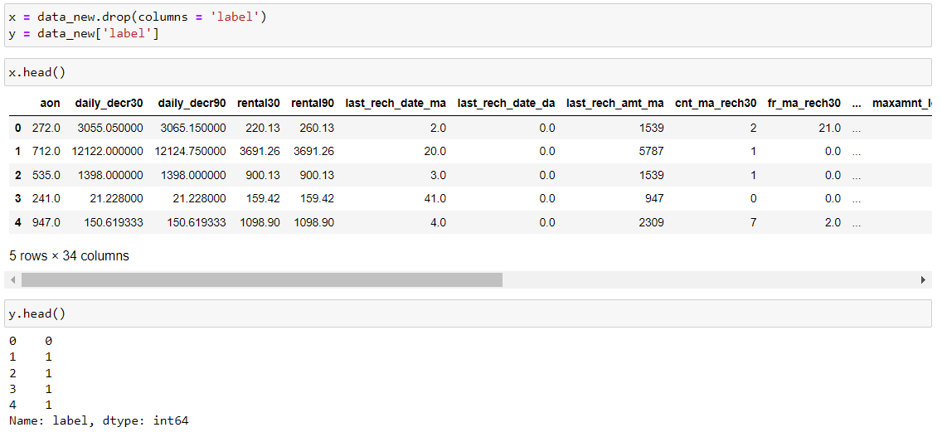
Before moving to the removal of the skewness present in the data we will first split the data and then scale the data which has features and then we will remove skewness.
Here in the above we have splitted the data into x and y variables where all the features are assigned to the variable “x” and the label column is assigned to the variable “y” and we transform the features present in the variable x to be scaled and then we will get a scaled and transformed data of x, which is used for removing the skewness present in the features.

Slide 22
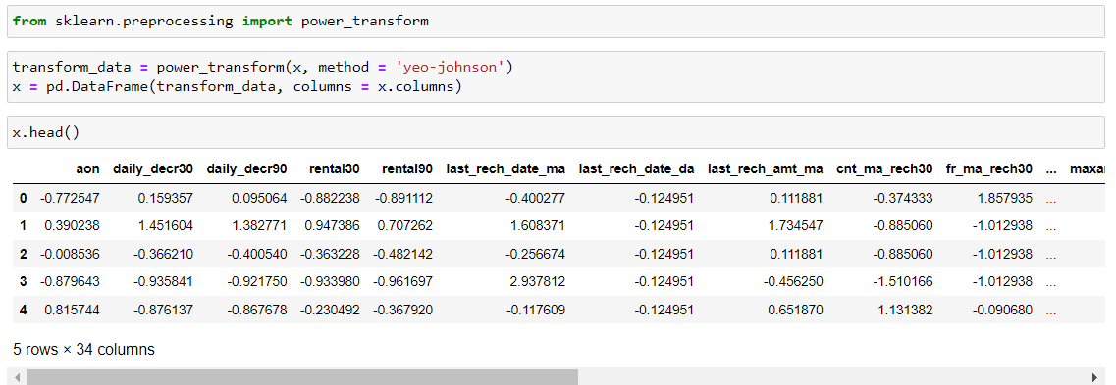
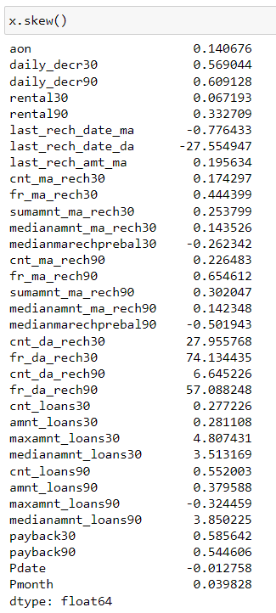
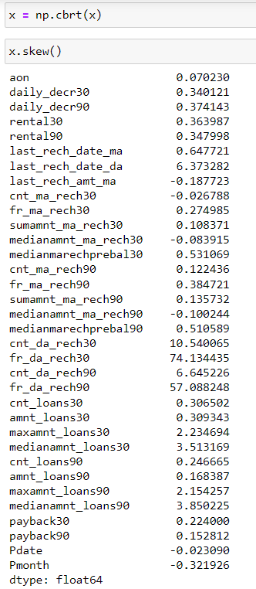
Removing the skewness of the data:
Here we can see that we have imported the “powertransform” library and passed the features present in the variable x into the powertransform and then we have removed the skewness of the data and converted into dataframe.
Now, here we have a look at the skewness of the features whether they are changed or not.
Here we can see that most of the features have change in their skewness but still we have skewness present and so we use “cuberoot” from NumPy and then we pass “x” into it and assign to the variable “x” again where we can see that most of the columns have a lot of changes in their skewness except few and so we can proceed with our model building.

Slide 23
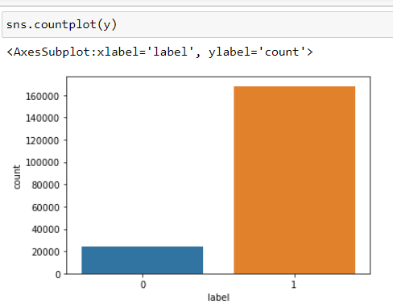
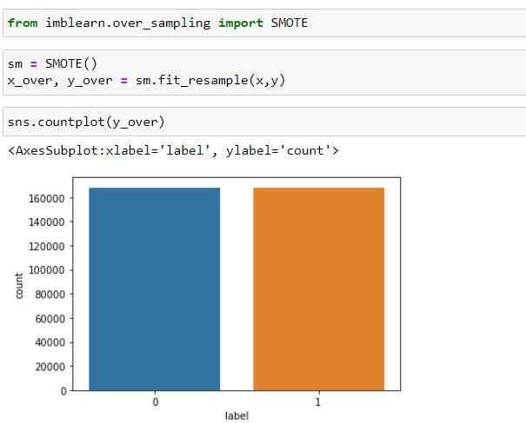
Balancing the imbalanced column "Label”:
Now we will balance the data as the data is imbalanced through the “oversampling” method where we import SMOTE to handle the imbalanced data.
Here we can see that we have balanced the imbalanced data and also we can see here that both of the attributes present in the label column which were actually imbalanced are now in equal proportions

Slide 24
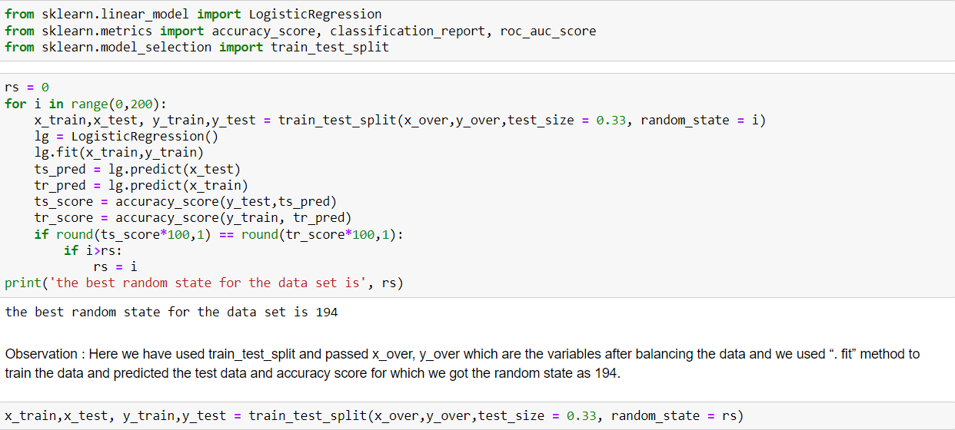
Checking the Random state:
Here we use train_test_split method for finding good random state number
Here we have used train_test_split and passed x_over, y_over which are the variables after balancing the data and we used “. fit” method to train the data and predicted the test data and accuracy score for which we got the random state as 194.

Slide 25
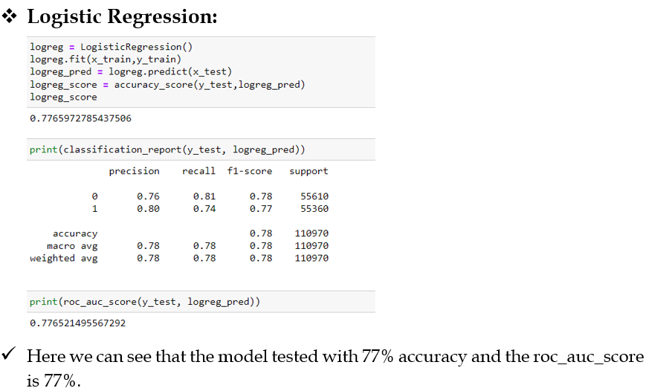
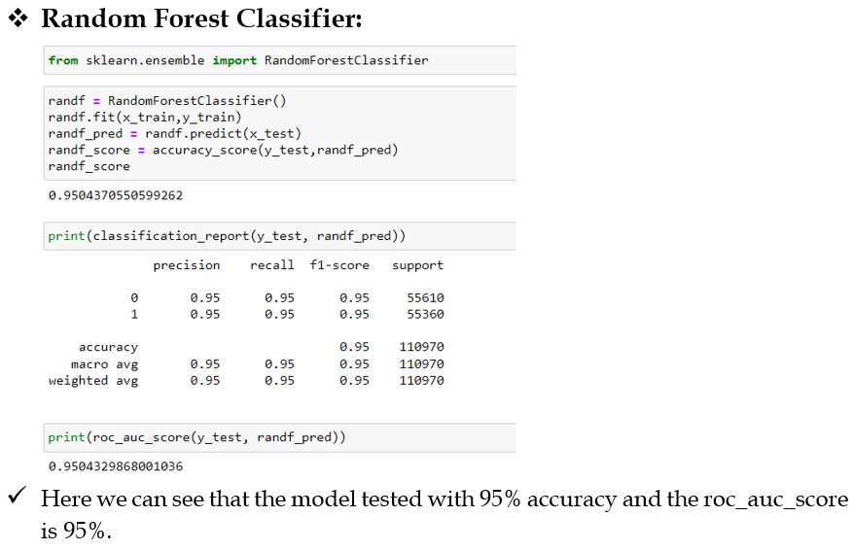
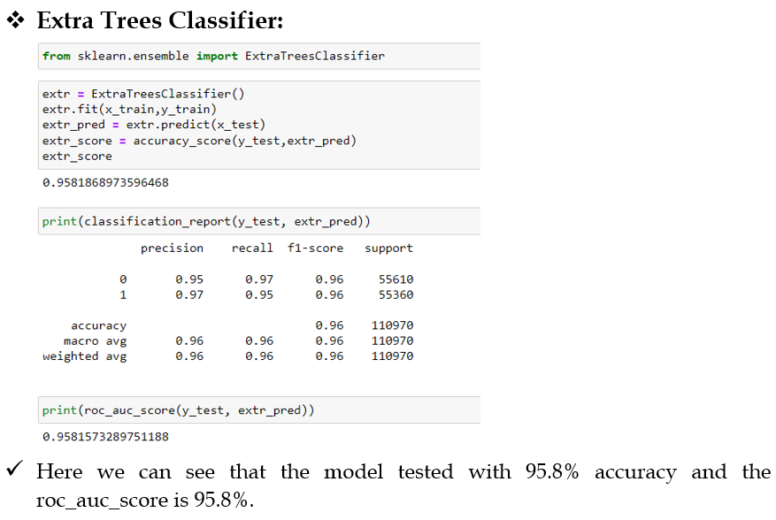
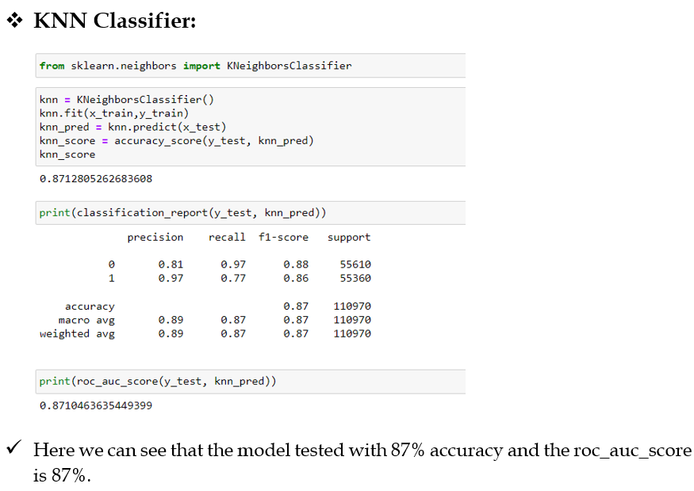
Building models:

Slide 26
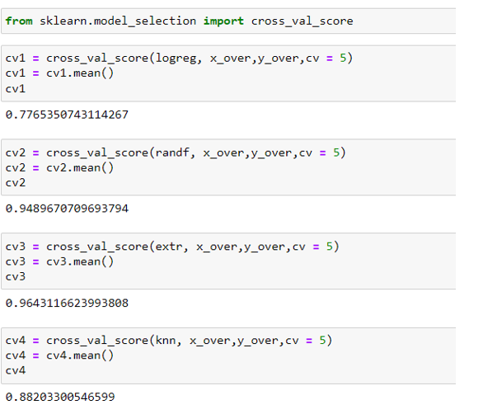
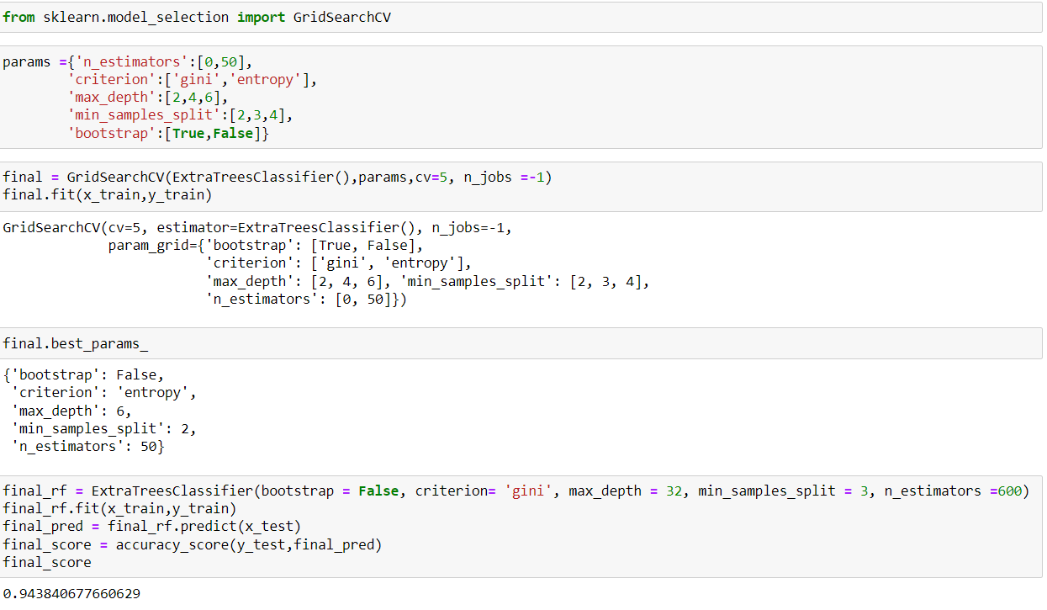
Checking for Cross Validation Score:
Here we can see that out of all the models used for prediction, Extra Trees Classifier model is with high accuracy score and also high cross validation score which is 96.4%.
Hyper parameter tuning:
Here we can see that we have imported “GridSearchCV” and we have used selected parameters and here we use Cross validation “5”, and we train the model and select the best parameters and also, we have predicted the final accuracy score which is 94.3%

Slide 27
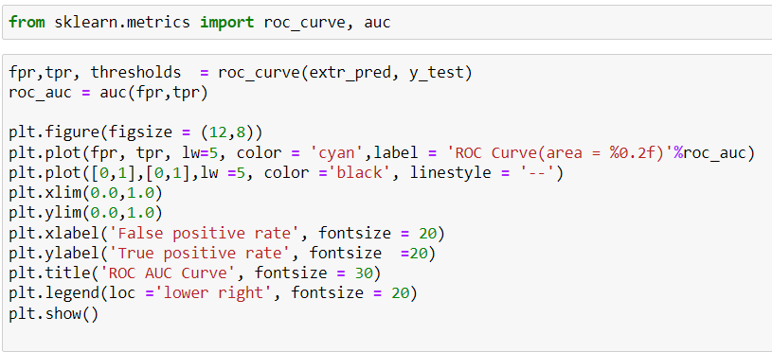
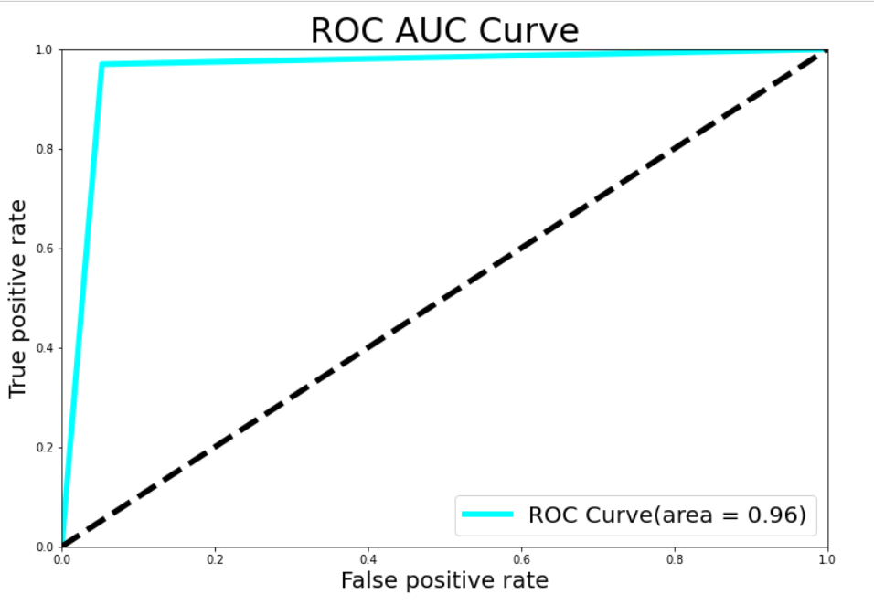
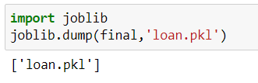
ROC and AUC Curve:
Here we have presented the ROC AUC Curve which we got 0.96
Save the model:
Finally, our model is saved and the file is “loan.pkl”.

Slide 28
CONCLUSION:
We have successfully built a model using multiple models and found that the Extra Trees Classifier model is the best model for predicting the values.
These are the keys which are used for model prediction of our dataset:
Average precision is 0.96
F1 Score is 0.96 and
ROC – AUC Score is also 0.958
We can see from the boxplot that we have a lot of outliers present in the data and I had to proceed with the outliers as I cannot afford to lose more data as the data is expensive.
Also, I couldn’t handle skewness completely inspite of using few transforming methods and so I had to proceed with skewness to build the model.
Looking at the heat map for correlation, I could see there were few independent variables which were correlated with each other, yet I have not removed any variable based on their correlation because multi-collinearity will not affect prediction.

Slide 29
Limitations of this work and Scope for Future Work:
Due to the presence of lot of outliers and also skewness for few variables, we are unsure whether the model is going to perform well to a completely new dataset.
There was Class Imbalance which had to be handled and for which we had to rebalance the data and by which we get completely new data and this may have certain affect on the model on the model building.

Slide 30


